Slide 1
HOUSING MARKETS: graphs & co.
Katarína Cechlárová
P. J. Šafárik University, Košice, Slovakia
Bilbao, October 23, 2015

Slide 2
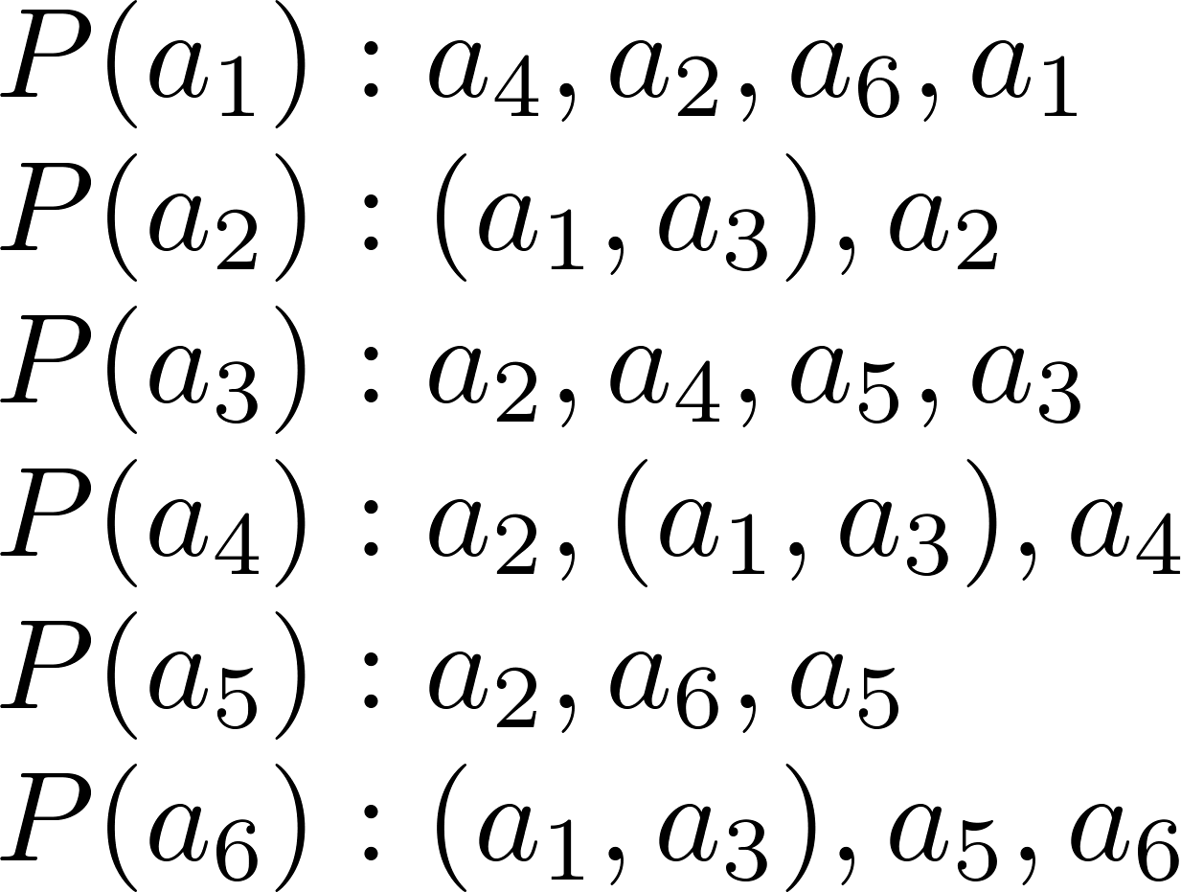
Housing market

Slide 3
Top Trading Cycles algorithm

Slide 4
Graphs – Who is who 1

Slide 5
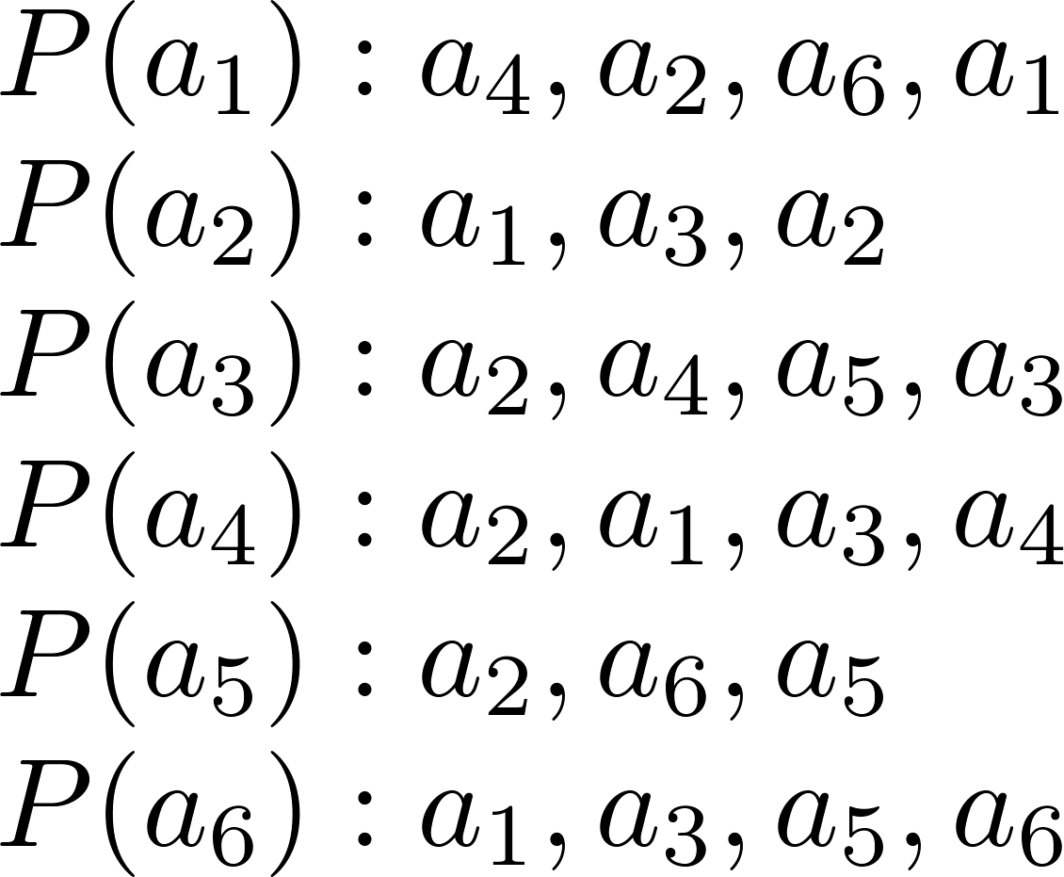
TTC algorithm for strict preferences

Slide 6
TTC algorithm for strict preferences

Slide 7
TTC algorithm for our example

Slide 8
TTC algorithm for our example

Slide 9
Graphs – Who is who 2

Slide 10
Algorithm to find strong core

Slide 11
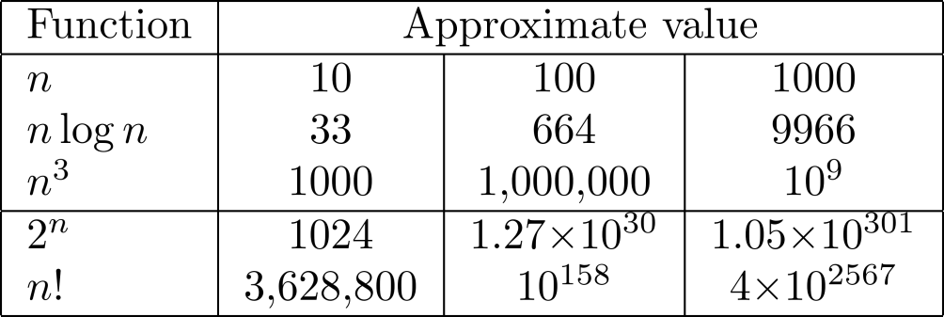
Computational complexity – Who is Who

Slide 12
Brief history: economic equilibrium

Slide 13
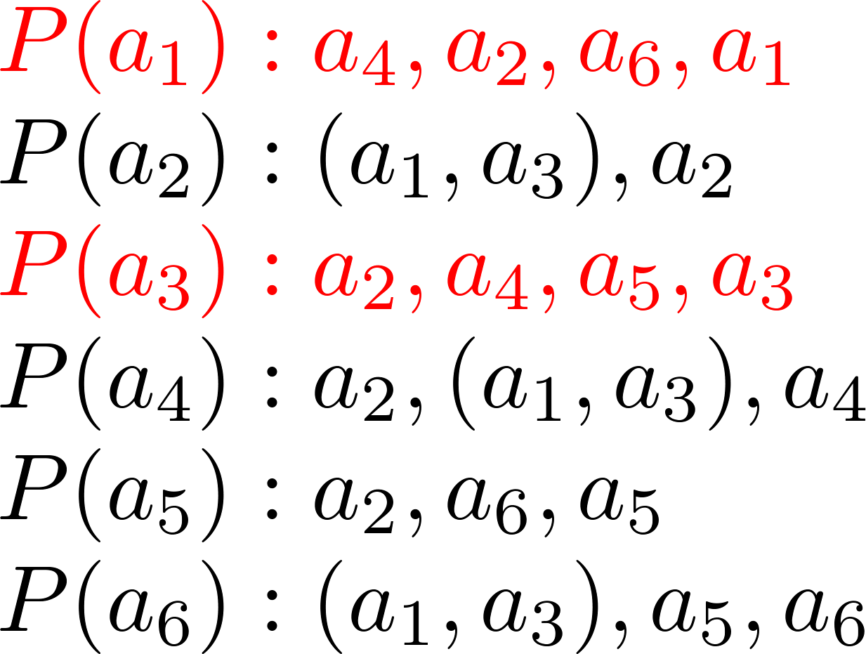
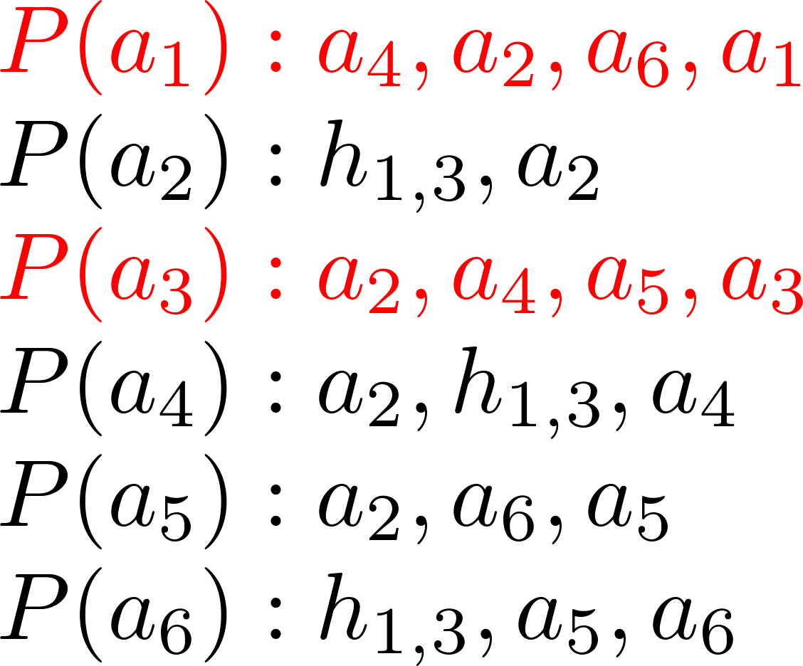

Slide 14
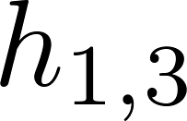
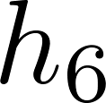
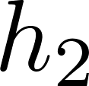
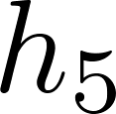
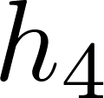

Slide 15
p₁ > p₂

Slide 16
Approximate equilibrium
Definition.

Slide 17
Approximate equilibrium
Definition.
Theorem (KC & Schlotter 2010).

Slide 18
Theorem (KC & Jelínková 2011).

Slide 19
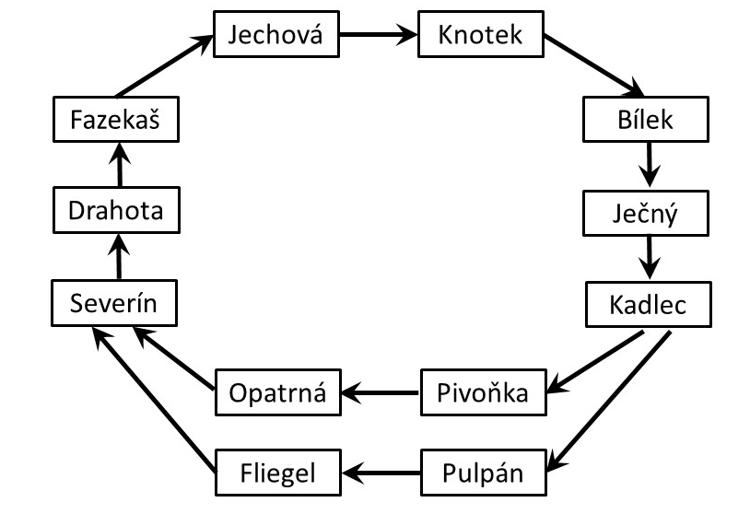
Motivation in the movie

Slide 20
Housing market with divorcing and engaged pairs

Slide 21
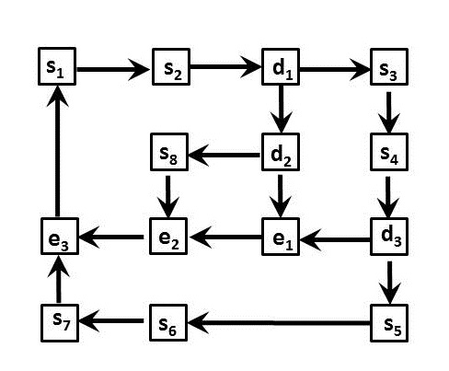
Each divorcing couple needs an egaged pair

Slide 22
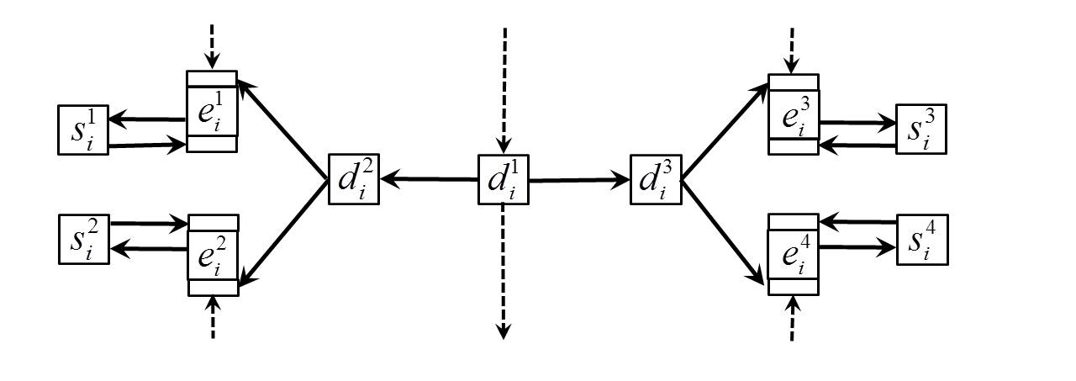
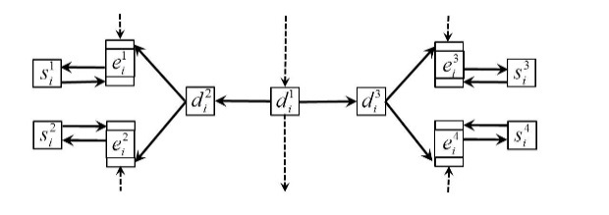

Slide 23
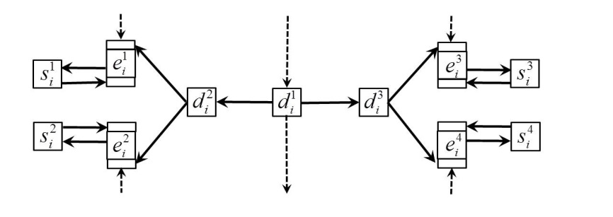
₁
₂
s_{K}

Slide 24
The talk was based on papers:
K. Cechlárová, T. Fleiner, Housing markets through graphs, Algorithmica 58/1, 170-187, 2010.
K. Cechlárová, E. Jelínková, An efficient implementation of the equilibrium algorithm for housing markets with duplicate houses, Information Processing Letters, 111/ 13, 667-670 (2011).
K. Cechlárová, I. Schlotter, Computing the Deficiency of Housing Markets with Duplicate Houses, LNCS 6478, Parameterized and Exact Computation, 72-83 (2010)
K. Cechlárová, E. Jelínková, Approximability of Economic Equilibrium for Housing Markets With Duplicate Houses, WG2011, LNCS 6986, eds. P. Kolman a J. Kratochvíl, 95-106 (2011)
K. Cechlárová, T. Fleiner , Zs. Janko, House-swapping with divorcing and engaged pairs, Preprint UMV UPJŠ, 2015.

Slide 25
Thank you for your attention!

